Slide 1
From risk analysis to adversarial risk analysis
Part VI. Adversarial risk analysis
David Ríos,
AXA-ICMAT Chair @ICMAT-CSIC and R. Academy

Slide 2
So far
Conceptual framework in RA
IDs as problem structuring tool
Probabilities for modeling uncertainty
Utilities for modeling preferences
Expected utilities for optimal alternatives
Computational framework for risk analysis
Basic concepts for game theory (towards RA)
This deck
An introduction to Adversarial Risk Analysis

Slide 3
Which is the best security resource allocation in a railway network?
  Railway Network as stations, lines (&hotspots )
  Threats: Pickpocketing, Fare evasion, Terrorism, …
  Each element has a value
  For each element, each threat, a predictive model of acts
  Allocate security resources (constraints)
  For each cell predict the impact of resource allocation
  Optimal resource allocation

Slide 4
Which is the best security resource allocation in a railway network?
  Railway Network as stations, lines (&hotspots )
  Threats: Pickpocketing, Fare evasion, Terrorism, …
  Each element has a value
  For each element, each threat, a predictive model of acts
  Allocate security resources (constraints)
  For each cell predict the impact of resource allocation
  Optimal resource allocation
  NB1: Bad guys operate intelligent and organisedly!!!

Slide 5
Which is the best security resource allocation in a railway network?
  Railway Network as stations, lines (&hotspots )
  Threats: Pickpocketing, Fare evasion, Terrorism, …
  Each element has a value
  For each element, each threat, a predictive model of acts
  Allocate security resources (constraints)
  For each cell predict the impact of resource allocation
  Optimal resource allocation
  NB1: Bad guys operate intelligent and organisedly!!!
  NB2: Different bad guys uncoordinated…

Slide 6
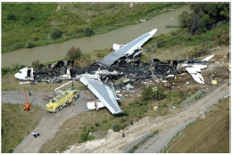
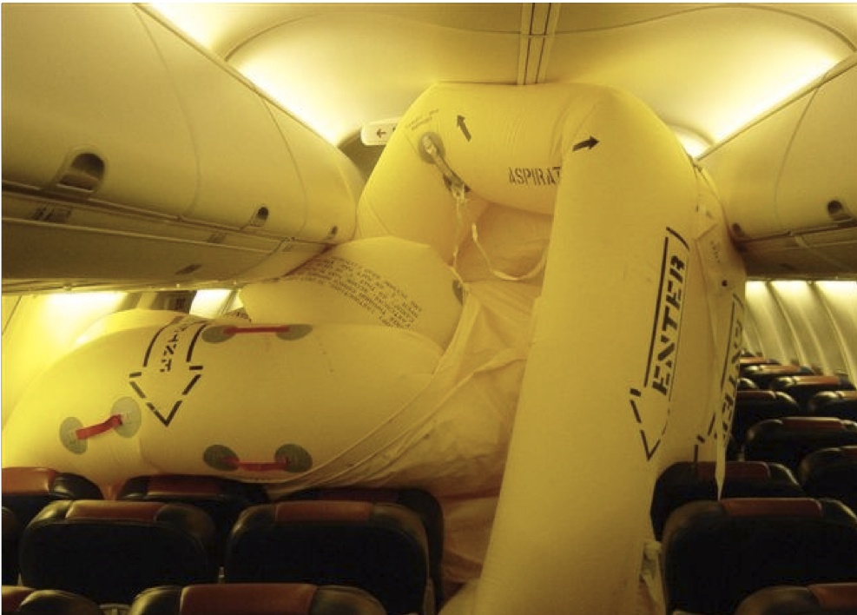
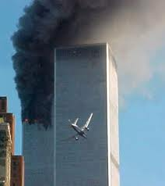
From RA to ARA…

Slide 7
Motivation
‘The World’s (23) Biggest Problems´ (Lomborg)
  Arms proliferation
  Conflicts
  Corruption
  Terrorism
  Drugs
  Money laundering
One of FP8 priorities (Secure Societies FCT, BD, DS)
One of 8 research challenges in Spain

Slide 8
Motivation
RA extended to include adversaries ready to increase our risks
S-11, M-11 lead to large security investments globally, some of them criticised
Many modelling efforts to efficiently allocate such resources
Parnell et al (2008) NAS review
  Standard reliability/risk approaches not take into account intentionality
  Game theoretic approaches. Common knowledge assumption…
  Decision analytic approaches. Forecasting the adversary action…
Merrick, Parnell (2011) review approaches commenting favourably on ARA

Slide 9
ARA
A framework to manage risks from actions of intelligent adversaries
  Banks, Rios, DRI Adversarial Risk Analysis (2015) Taylor Francis
One-sided prescriptive support
  Use a SEU model
  Treat the adversary’s decision as uncertainties
Method to predict adversary’s actions
  We assume the adversary is a expected utility maximizer
    Model his decision problem
    Assess his probabilities and utilities
    Find his action of maximum expected utility
  (But other descriptive models are possible)
Uncertainty in the Attacker’s decision stems from
  our uncertainty about his probabilities and utilities
  but this leads to a hierarchy of nested decision problems
  (random, noninformative, level-k, heuristic, mirroring argument,…) vs (common knowledge)
Kadane, Larkey (1982), Raiffa (1982, 2002)
Lippman, McCardle (2012)
Stahl and Wilson (1994, 1995) D. Wolpert (2012)
Rothkopf (2007)

Slide 10
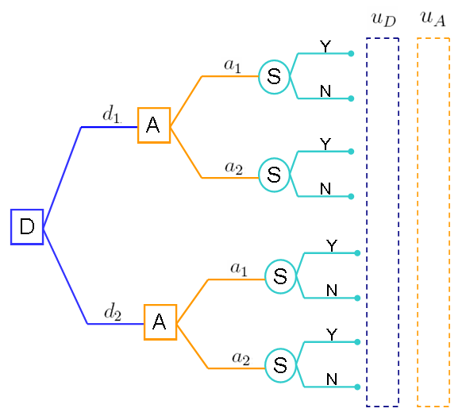
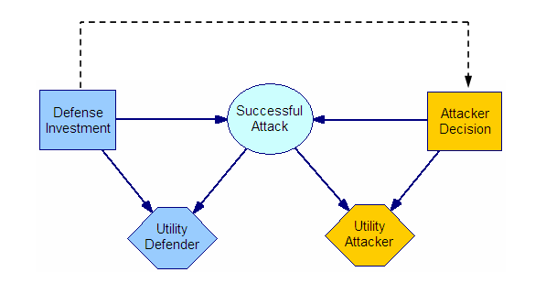


First Defender, afterwards Attacker
Nash Solution, SPE:
Standard
Game Theory Analysis

Slide 11
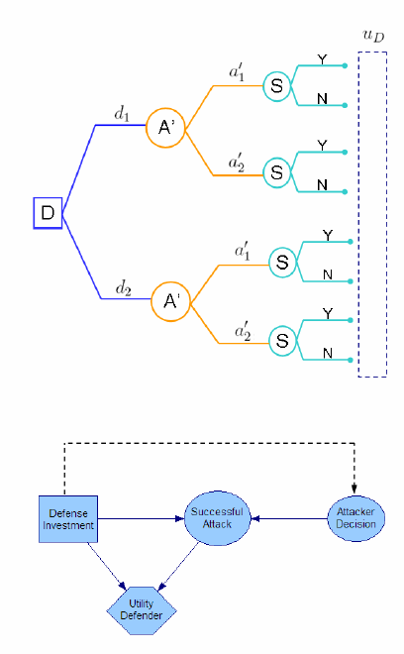





Supporting the Defender
Defender problem
Defender’s solution
Modeling input:
??

Slide 12

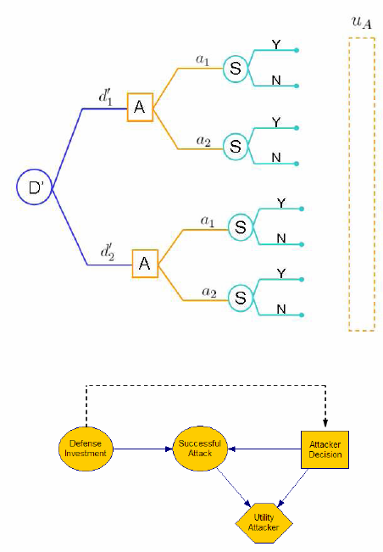







Supporting the Defender:
The assessment problem
Defender’s view of Attacker problem
Elicitation of
Assume A is a EU maximizer
D’s beliefs about
MC simulation
where

Slide 13
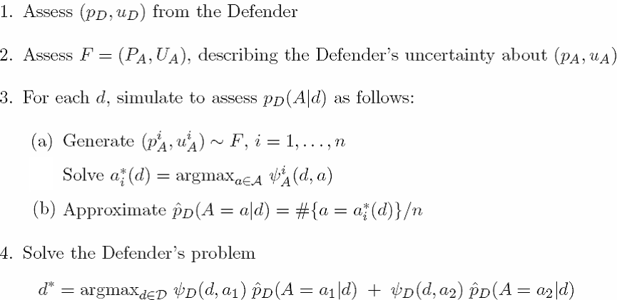
Sequential D-A

Slide 14
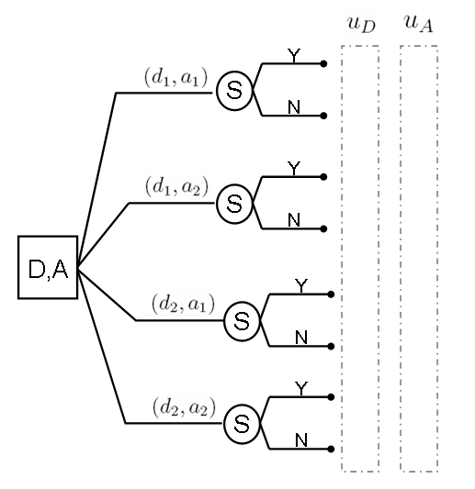
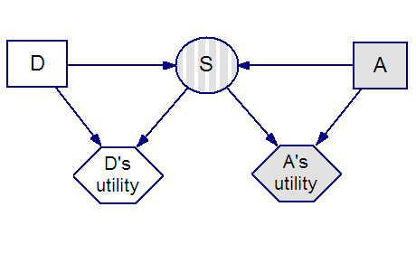
Simultaneous games
Decisions are made without knowing each other’s decisions

Slide 15
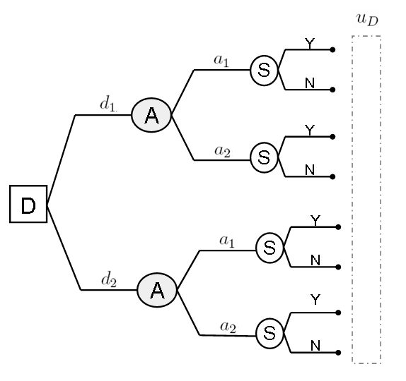
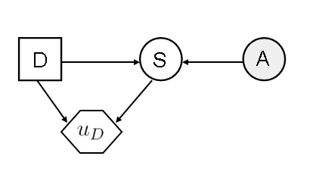
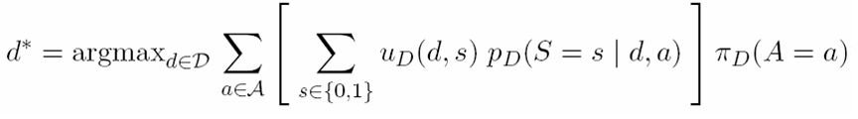
Supporting the Defender
Defender’s decision analysis
How to
assess it ??

Slide 16


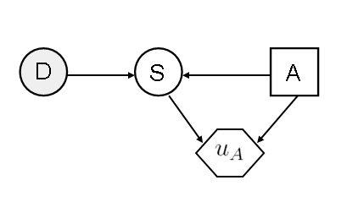
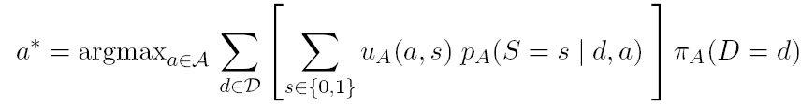

Assessing
Attacker's decision analysis as seen by the Defender

Slide 17



The assessment problem
To predict Attacker’s decision
The Defender needs to solve Attacker’s decision problem
She needs to assess
Her beliefs about are modeled through a probability distribution
The assessment of requires deeper analysis
  D’s analysis of A’s analysis of D’s problem
It leads to an infinite regress
thinking-about-what-the-other-is-thinking-about…

Slide 18
Hierarchy of nested models
Stop when the Defender has no more information about utilities and probabilities
at some level of the recursive analysis. Level-k thinking

Slide 19
Opponent modeling
Non strategic
Nasheq
Level-k
Mirroreq
Prospectmax
Reconcile them through a mixture
DRI, Banks, Rios (2015) RA

Slide 20
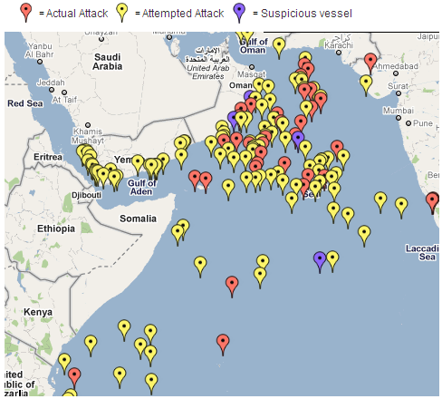
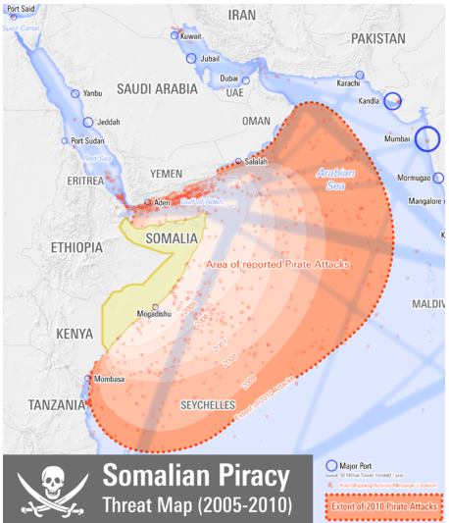
Piracy in Somalia
Piracy and armed robbery incidents reported to the IMB Piracy Reporting Centre 2011

Slide 21
The Defend–Attack–Defend model
Two intelligent players
  Defender and Attacker
Sequential moves
  First, Defender moves
  Afterwards, Attacker knowing Defender’s move
  Afterwards, Defender again responding to attack

Slide 22
The Somali Pirates Case: Problem formulation
Two players
  Defender: Ship owner
  Attacker: Pirates
Defender first move
  Do nothing
  Private protection with an armed person
  Private protection with a team of two armed persons
  Go through the Cape of Good Hope avoiding the Somali coast
Attacker’s move
  Attack or not to attack the Defender’s ship
Defender response to an eventual kidnapping
  Do nothing
  Pay the ransom
  Ask the Navy for support to release the boat and crew

Slide 23

(nothing)
S,P
S = 1
(pay)
(attack)
(Navy)
S
(nothing)
S = 0
A
(no attack)
(nothing)
S = 1
(pay)
(attack)
(Navy)
S
(man)
S = 0
A
(no attack)
(nothing)
S = 1
(pay)
(attack)
(Navy)
S
(team)
S = 0
A
(no attack)
(alternative route)

Slide 24
Defender’s decision analysis
(nothing)
15.16
S = 1
(pay)
2.3
(attack)
(Navy)
(nothing)
S
4.28
A
S = 0
0
(no attack)
0
(nothing)
17.25
S = 1
(pay)
4.39
(attack)
(Navy)
6.37
S
(man)
S = 0
0.05
A
(no attack)
0.05
(nothing)
19.39
S = 1
(pay)
6.53
(attack)
(Navy)
S
8.51
(team)
S = 0
A
0.15
(no attack)
0.15
(alternative route)
0.5

Slide 25
ARA: Cases
Problem | Defender | Attacker | Specificities | Template
ATC protection | Airport authority | Terrorist | Single site | D-> A
Piracy | Ship owner | Pirates | Single site | D- >A - > D
Metro | Operator | Pickpock Fare evasion | Multisite Multiattack, Cascade | D->A
Urban security | Police | Mob | Multisite spatial | D->A->D
Train | DoT, DoD | Terrorist | Multisite network | D->A->D
Reliability | Manufacturer | Customer | -- | D->A
SME IS | Company | Competitor | Cyber, Integrated with RA | D->A
Oil rig cybercontrolled | Oil company | Sponsored hackers | Cyber, Multiattack | D->A->D
UAV fight | Country | Country | Multisite | D->A->D
CI | Owner | Terrorist | Multistage | General
Cybersec res allocation+cybins | IT Owner | Hacker(s) | Several decisions Random and targeted attacks | D-A, D-A-D
Social robots | Robot | User | Sequential | D->A

Slide 26
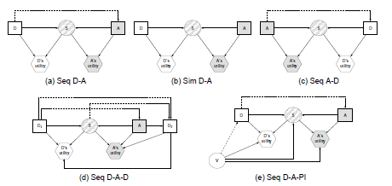
ARA templates

Slide 27
ARA templates

Slide 28
More general interactions

Slide 29
ARA vs GT
Provide different solutions
Dominance and ARA
‘Iterated dominance’ and ARA
Ficticious play and ARA
Level-k and ARA
GT, Sensitivity analysis, If sensitive, ARA.
Different types of adversaries

Slide 30
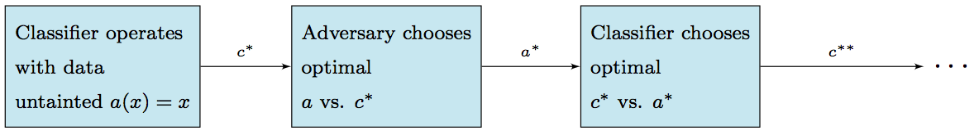
Adversarial classification as a game
C, classifier. A, adversary
Two classes: + malicious; - innocent.
C and A maximise expected utility under common knowledge conditions
Finding Nash equilibria extremely complex
Dalvi et al (2004) propose a scheme
Utility sensitive Naive Bayes
Forward myopic approach under strong common knowledge
Notes:
Adversarial classification is a game between C a classifier and A an adversary taking into account two kind of classes malicious and innocent. Both players wants to maximise their expected utility under very strict common knowledge assumptions. In this game, to find Nash equilibria is very complex as is mention in Adversarial Classification from Dalvi et al paper which they propose an utility sensitive Naïve Bayes myopic approach
Explain graph

Slide 31
Adversarial problems

Slide 32
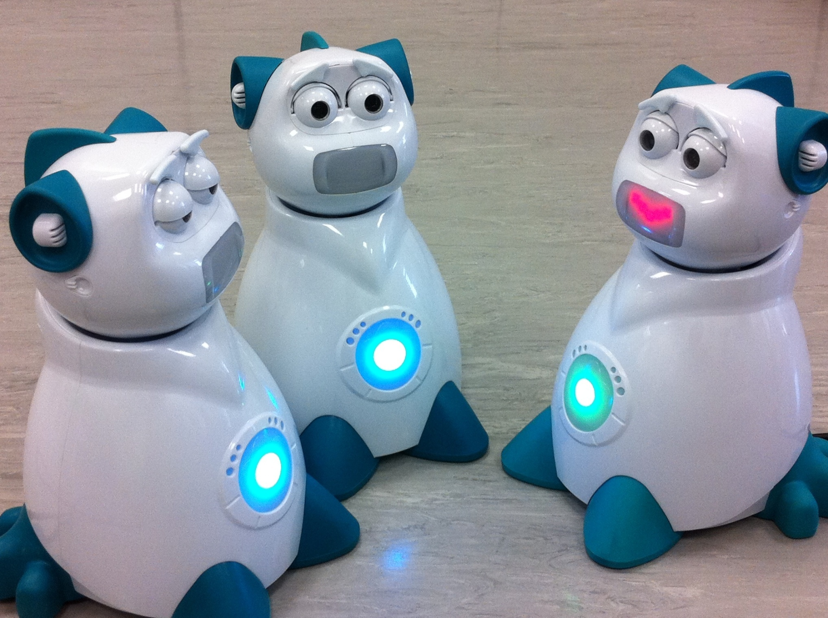

Slide 33
Problem
An agent makes decisions in a finite set
Has sensors providing information around it
It relates with a user which makes decisions
They’re both within an environment which evolves (under the control of the user)

Slide 34
Basic framework
Leer sensores s_{t}
Interpretar
estado e_{t}
Inferir
acción b_{t}
Deducir
estado
emocional
Actualizar
modelo
predicción
Elegir
acción a_{t+1}
Actualizar
reloj
Notes:
34

Slide 35
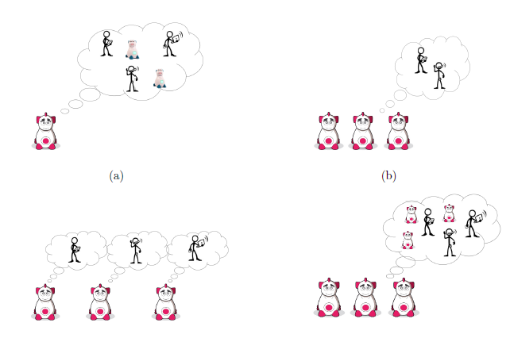
Basic framework (Si Liu)
Several bots:
Support each of the bots, treat the other bots as users (selfish 1). ARA
Allow them to communicate, compute nash equilibria (selfish 2)
If they communicate, from selfish to cooperative. ARA
Emotions impacting degree of cooperativeness
Notes:
35

Slide 36
Other themes
Differential games
Multiagent reinforcement learning
Competition and cooperation
Partial information
Cybersecurity and cyberinsurance
Efficient computational schemes
Computational environment
Fake news
Malware detection
Attacker models
Generative adversarial networks
Generic approach: point estimation, interval estimation,…
Multiple attackers, Multiple defenders

Slide 37
Wrapping up
Conceptual framework in RA
IDs as problem structuring tool
Probabilities for modeling uncertainty
Utilities for modeling preferences
Expected utilities for optimal alternatives
Computational framework for risk analysis
Basic concepts for game theory (towards RA)
An introduction to Adversarial Risk Analysis
Questions david.rios@icmat.es Skype: david.rios.insua

Slide 38
谢谢
david.rios@icmat.es
PhD opportunities
https://www.icmat.es/job-opportunities/inphinit_la-caixa/

